Slide 1



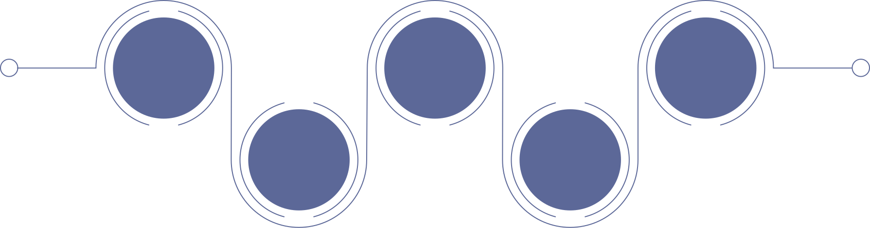
MULTILINGUAL MEDICAL REPORT SYSTEM
GROUP MEMBER:
EMAN WAHEED(027)
LAIBA RANI(053)
ZAINAB SALEEM(093)
SANIA ARSHAD(098)

Slide 2



Overview
The Multilingual Medical Report System is a web-based application developed to manage and translate medical reports.
It allows patients, doctors, and administrators to interact with medical data securely.
The system supports multiple languages, making medical information easier to understand for users from different linguistic backgrounds.
Users can register, log in, upload medical reports, translate reports, and share them securely.
The backend is developed using PHP, with database management
through PHPMyAdmin, ensuring reliable connectivity and data storage.

Slide 3


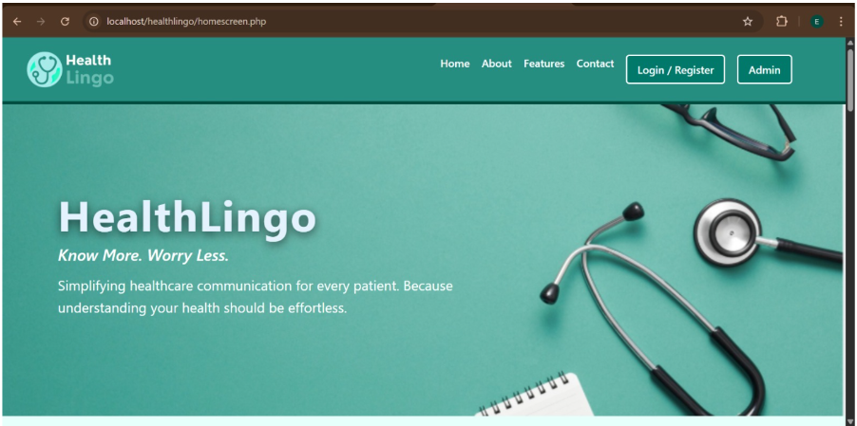


Introduction
This project is a web-based system for viewing medical reports.
It allows users to read their reports in Medical reports are usually written in complex medical terminology
Most medical reports are available only in English
Many patients face difficulty understanding their medical condition
Language barriers lead to miscommunication in healthcare
A multilingual system is required to improve patient understanding

Slide 4


OBJECTIVES
To provide multilingual medical reports
To reduce language barriers in healthcare
To improve patient understanding of medical information
To ensure secure storage of medical data
To provide easy access to medical reports

Slide 5




Technologies Used
Frontend: HTML, CSS, JavaScript
Backend: PHP
Database: MySQL (PHPMyAdmin)
Server: Localhost / Web Server
Tools: VS Code, Browser, Canva

Slide 6
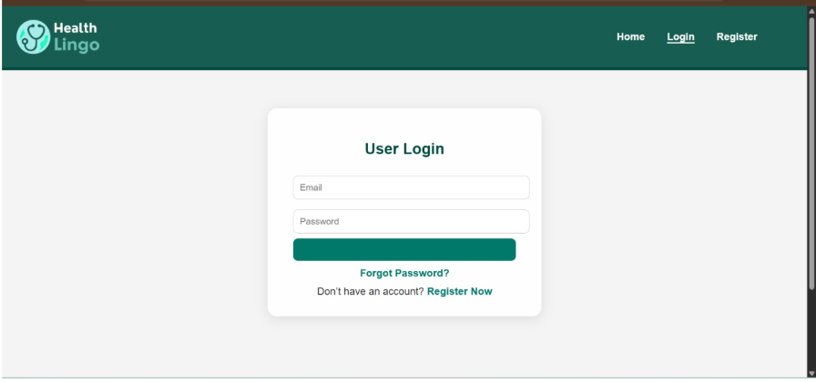
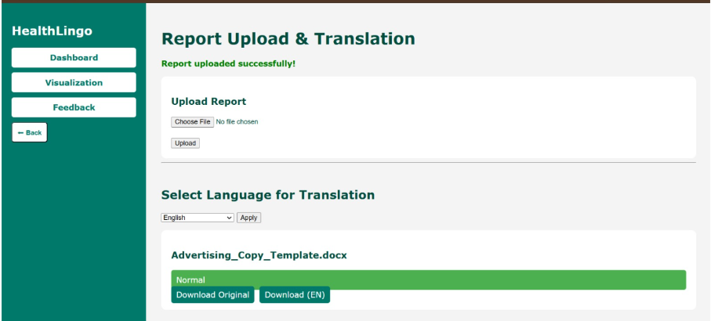

FUNCTIONAL REQUIREMENTS
User Registration & Login: Secure authentication.
Report Upload: Upload medical reports.
Report Translation: Translate into multiple languages.
Feedback Submission: Provide feedback.
Secure Messaging: Share reports safely with doctors.

Slide 7


NON-FUNCTIONAL REQUIREMENTS
High system performance.
Secure authentication and authorization.
Data privacy and confidentiality.
Easy navigation and usability.
Scalability for future features.
Browser and device compatibility.

Slide 8


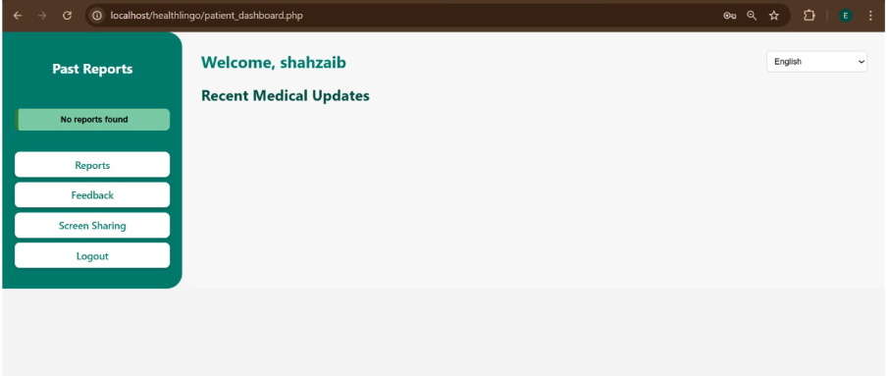
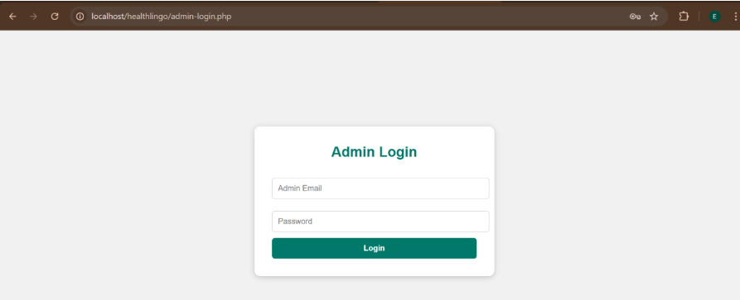
USER REQUIREMENTS
Patients: Upload, view, and translate reports.
Doctors: Access patient reports and translations.
Admin: Manage users, reports, and feedback.

Slide 9
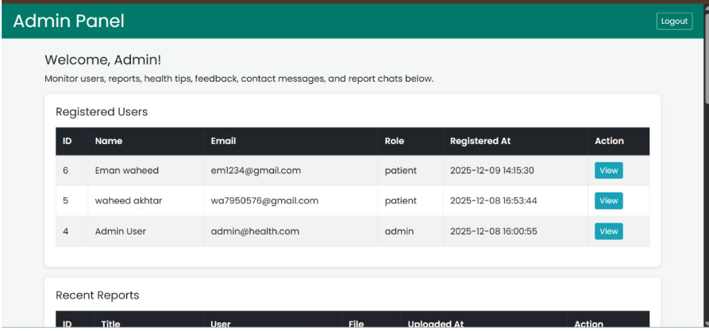
Admin Panel
View all users and uploaded reports.
Approve, delete, or manage reports.
Monitor and respond to feedback.

Slide 10

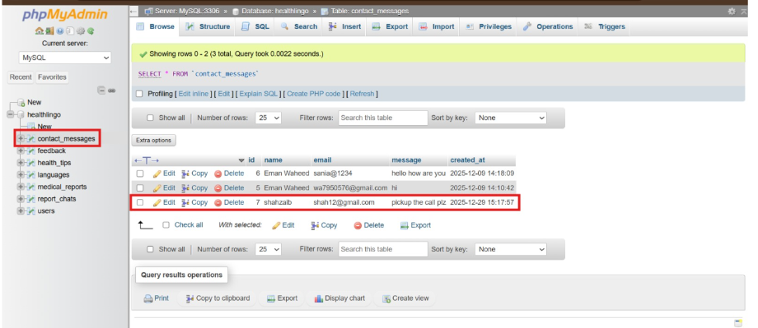
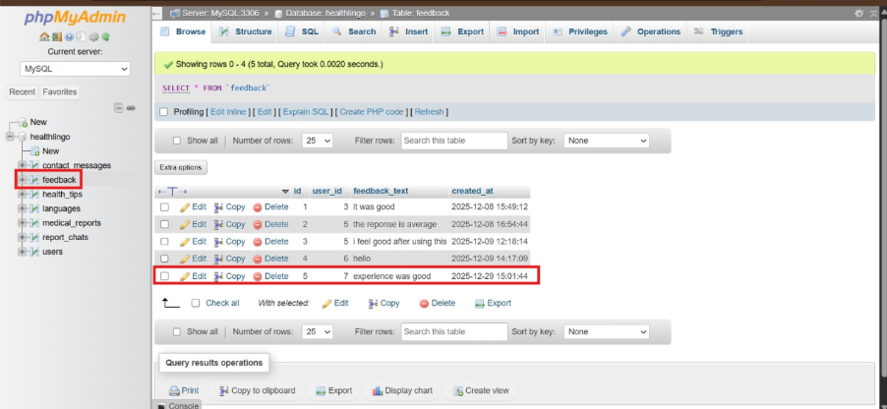
Database & Connectivity
Database in PHPMyAdmin.
Tables: Users, Reports, Feedback, Messages.
Backend: PHP handles data storage and retrieval.
Ensures real-time data access.

Slide 11

Conclusion
Multilingual Medical Report System improves healthcare communication
Reduces language barriers between doctors and patients
Helps patients understand medical reports easily
Provides secure and efficient medical data management
Suitable for modern web-based healthcare systems

Slide 12
THANK YOU

